Slide 1
Comparative Analysis of the U.S. and the British Embassies’ Facebook Activities in Tashkent: A Public Diplomacy Perspective
By Y.N.,
Q.B.,
E.R.,
E.O.,
and Y.B.

Slide 2
In my Public Diplomacy class at UWED, our 4th year students did some case studies on using social networks by the foreign diplomatic actors. One of these cases is “The Comparative Analysis of the U.S. and the British Embassies’ Facebook Activities in Tashkent: A Public Diplomacy Perspective”. Below I provide the students’ PPT presentation. The work has been done by 5 students: Y.N., Q.B., E.R., E.O., and Y.B. Obviously, it is not a comprehensive research, but rather a genuine attempt of the students to understand the mechanisms of using the social media in public diplomacy.

Slide 3
Plan:
Introduction
Post Content
Engaging Public
Visual Images
Conclusion

Slide 4
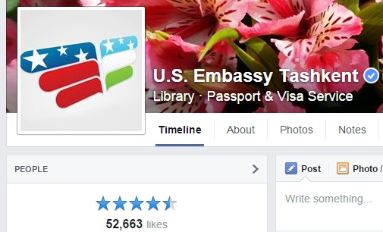
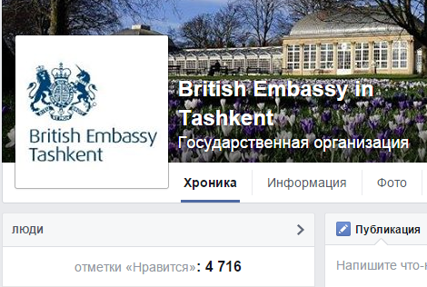
Introduction

Slide 5
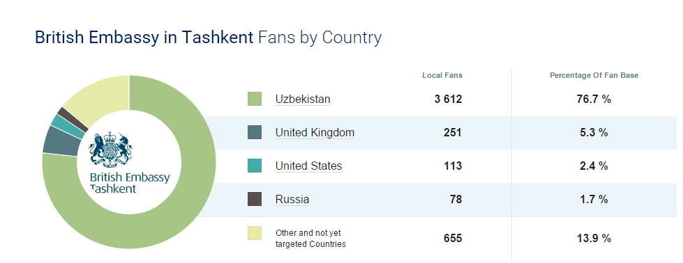
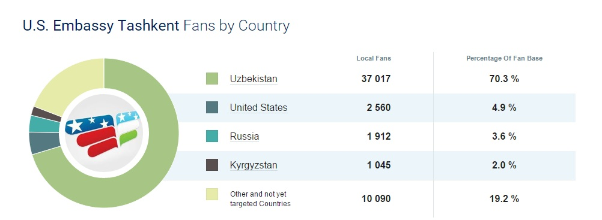

Slide 6
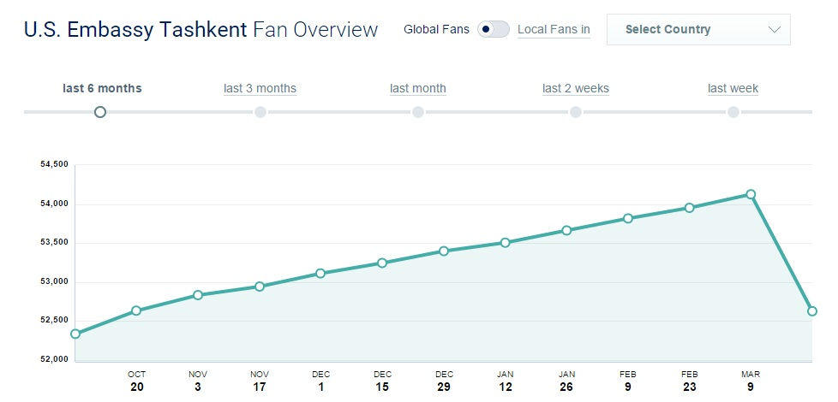
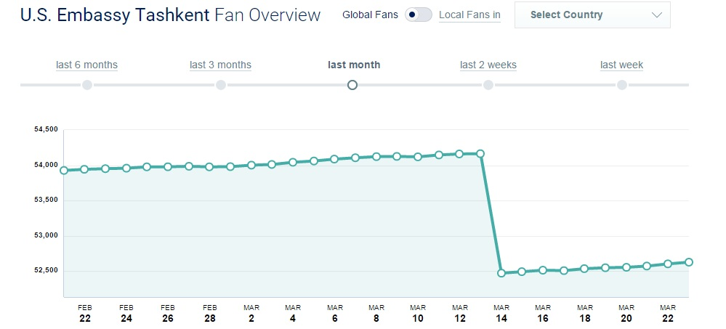

Slide 7
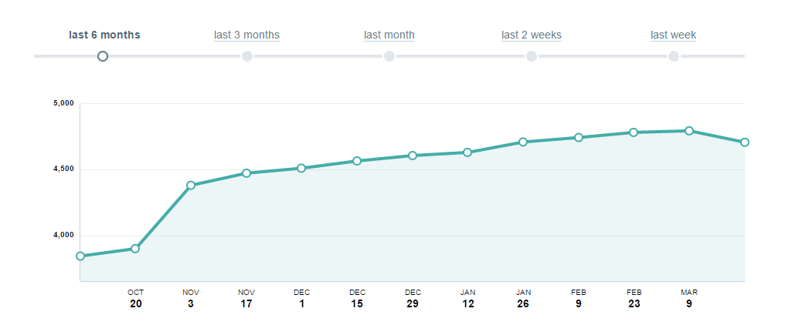
British Embassy in Tashkent Fans Overview

Slide 8
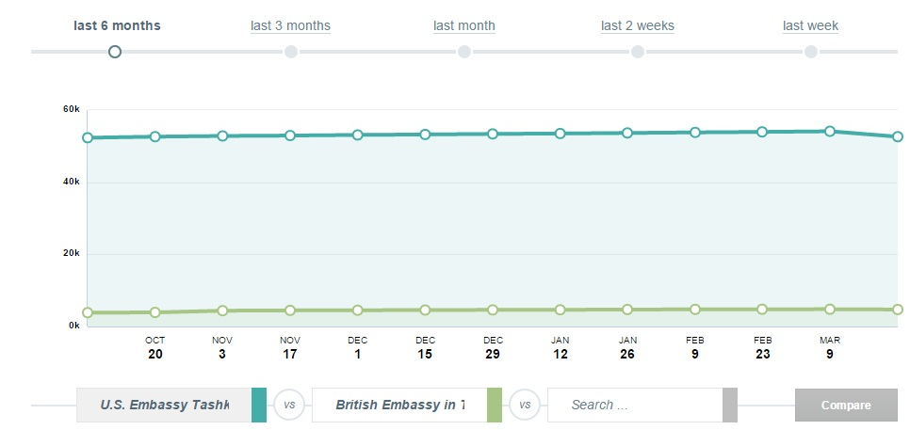
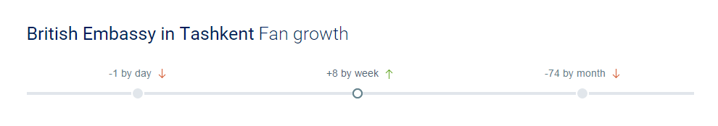
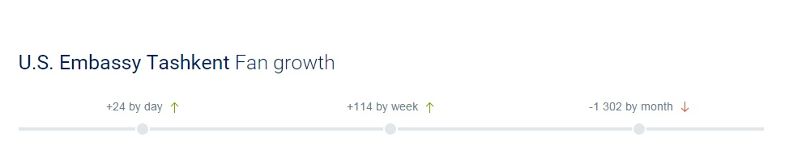
Fans overview comparison

Slide 9
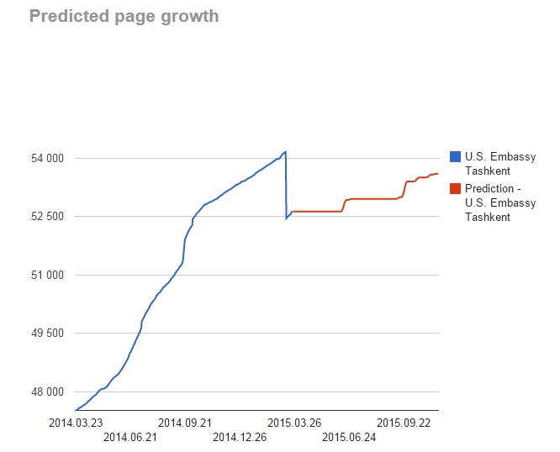

Slide 10
Gender proportion of followers

Slide 11
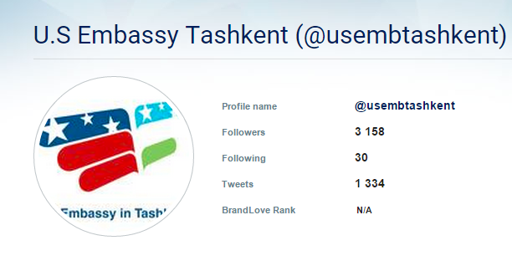
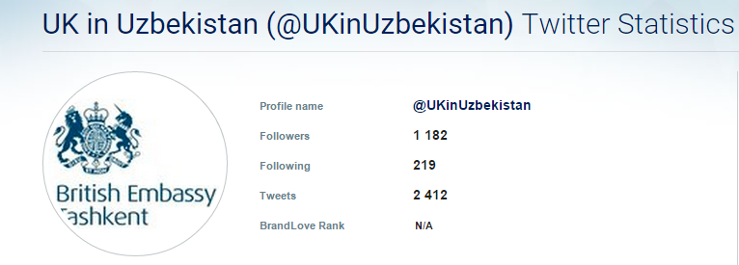
Twitter

Slide 12
Post Analysis

Slide 13
Frequency of publications
The period considered: 01.01.2015-23.03.2015
 | Total amount of posts | Per day
US Embassy | 83 | 1.01
British Embassy | 94 | 1.14

Slide 14
Post content
 | Formal | Informal | About their own country | About host country
US Embassy | 41 | 42 | 44 | 21
British Embassy | 46 | 35 | 64 | 16

Slide 15
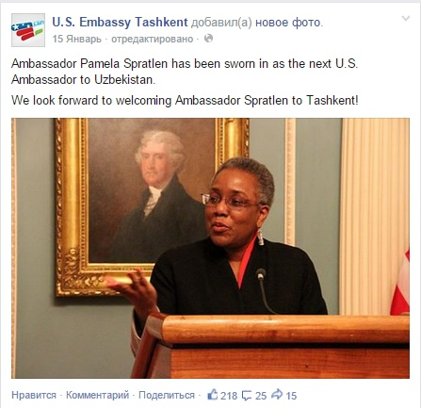
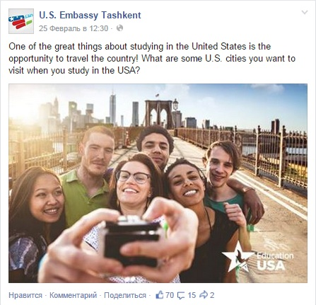
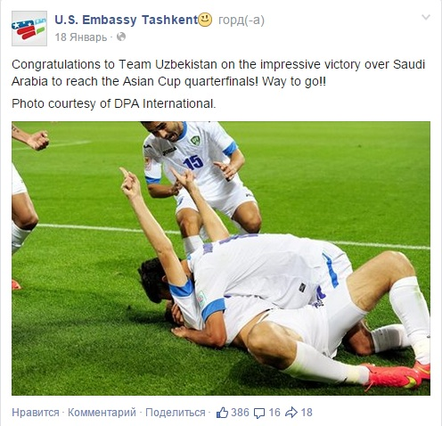
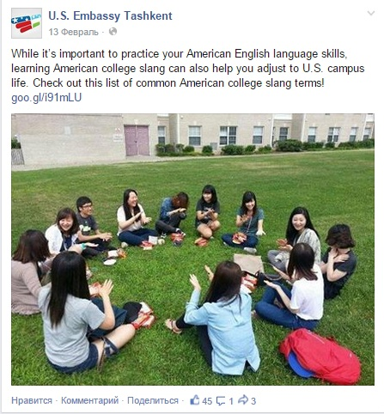
US Embassy

Slide 16
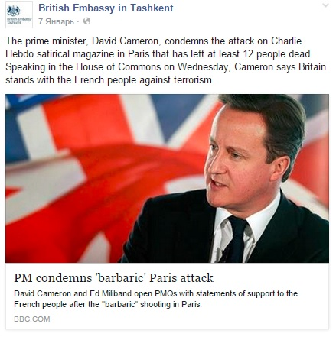
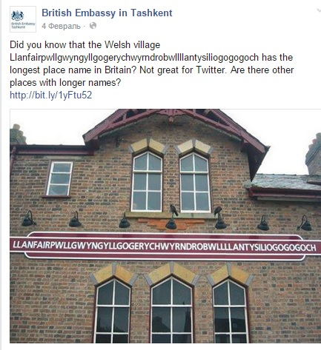
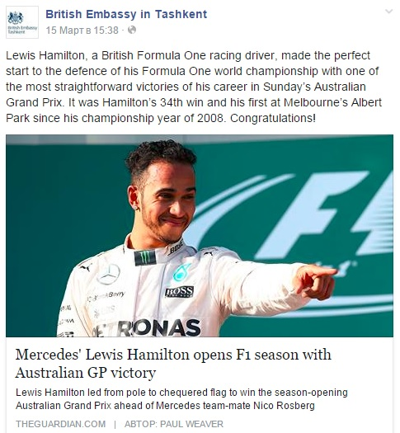
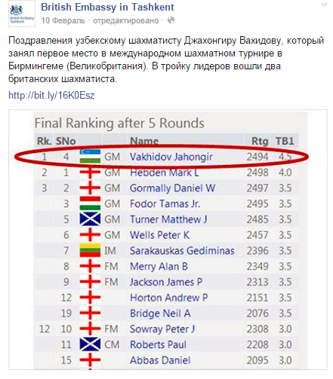
British Embassy

Slide 17
US Embassy FB Page

Slide 18
British Embassy FB Page

Slide 19
 | Repost of official information | Ads, announcements, third party information
US Embassy | 13 | 17
British Embassy | 16 | 22

Slide 20
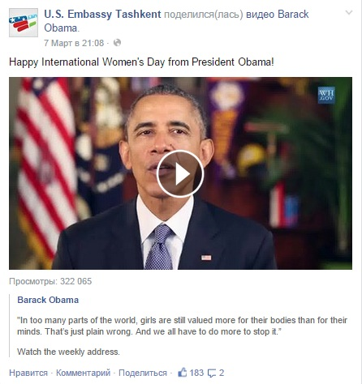

In cases of US Embassy Page

Slide 21
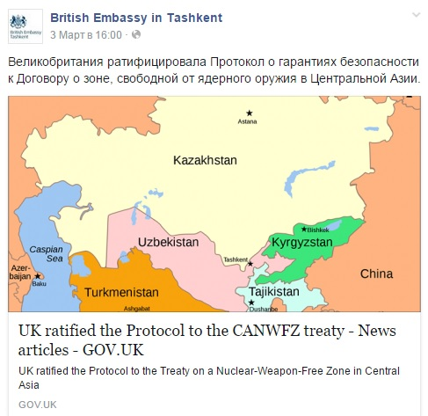
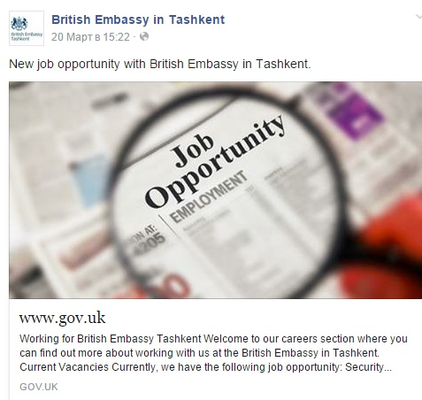
In cases of British Embassy Page

Slide 22
Use of Local Languages in the Posts
 | Uzbek | Russian
US Embassy Page | 4 | 3
British Embassy Page | 1 | 27
Coverage of Ambassadorial Activity
US Embassy Page | British Embassy Page
15 | 12

Slide 23
Public Engagement
 | US Embassy Page | British Embassy Page
Quizzes | 0 | 2
Questions | 12 | 4
Discussions | 0 | 3

Slide 24
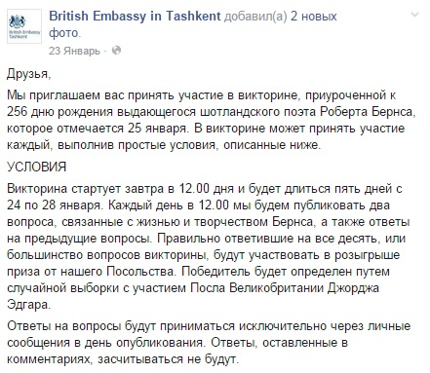
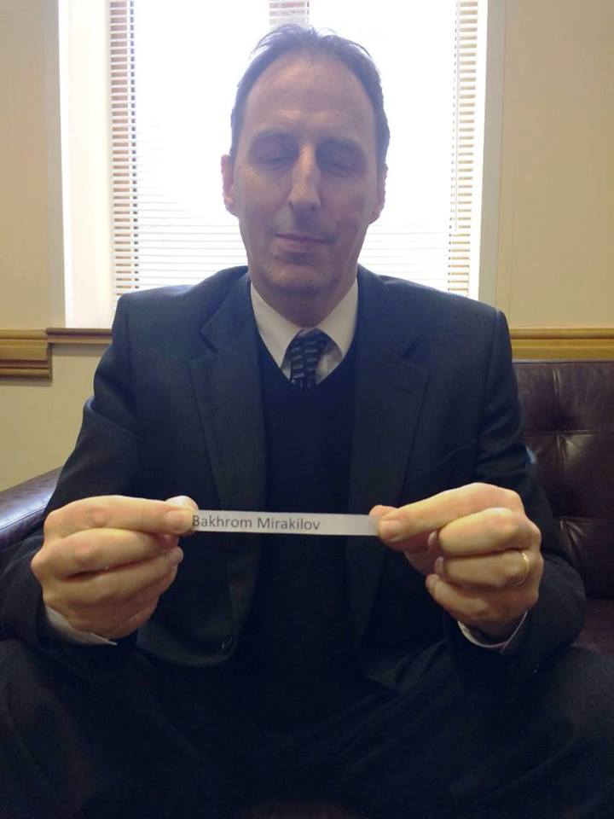

Slide 25
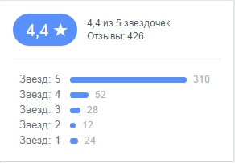
Rates (in US Embassy Page’s Case)

Slide 26
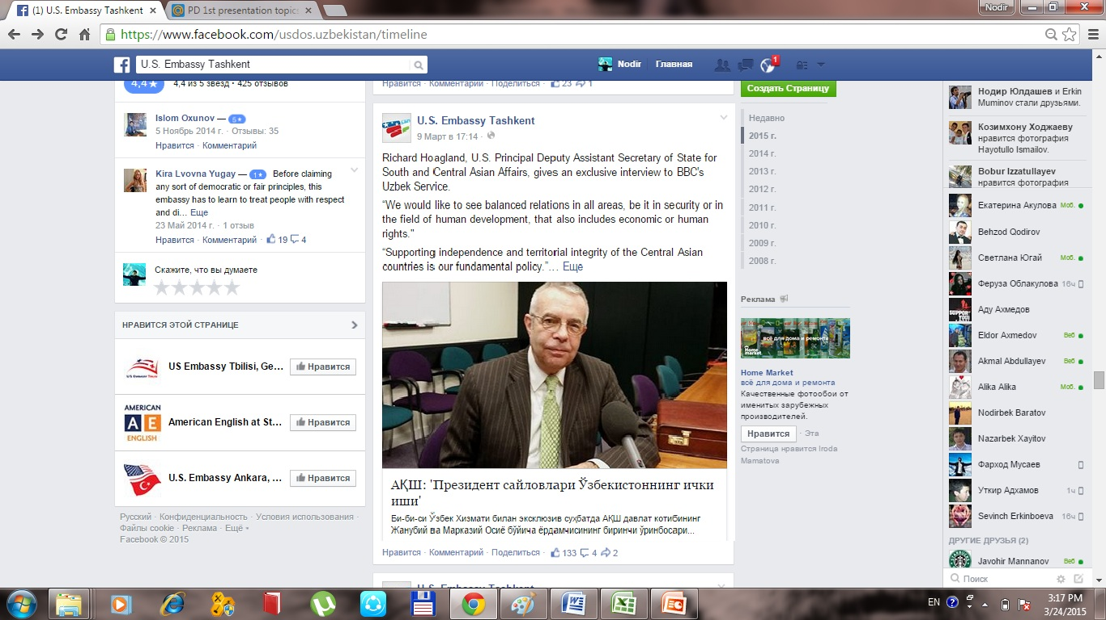
About Presidential Elections

Slide 27
The amount of Critical posts
British Embassy page
0
US Embassy page
0

Slide 28
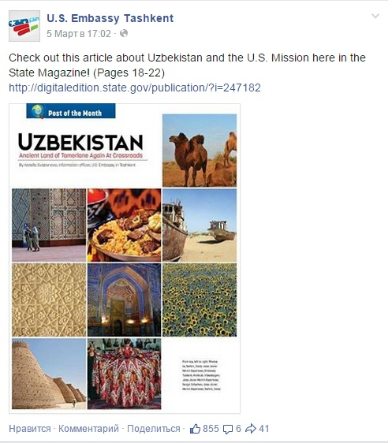
Most liked and discussed posts in US Embassy Page

Slide 29
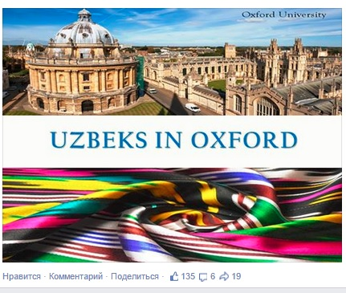
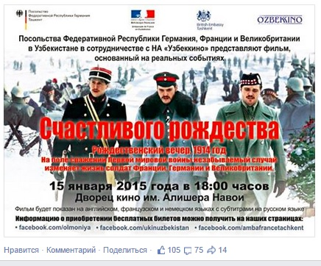
British Embassy page
Most liked and reposted one
Most commented one

Slide 30
Images
 | Total visual images | Use of official symbols
US Embassy Page | 135 | 22
British Embassy Page | 112 | 5

Slide 31






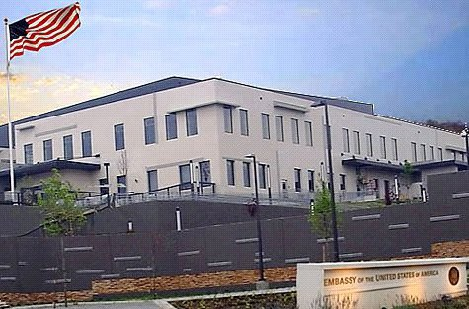

US Embassies Logos UK Embassies Logos

Slide 32
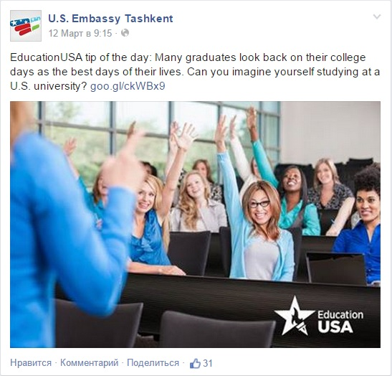



Slide 33
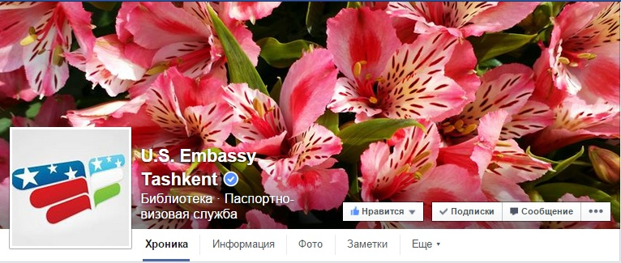
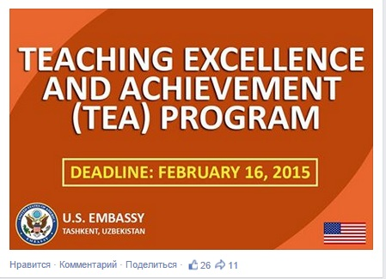
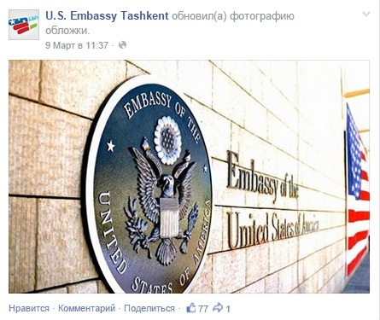

Slide 34
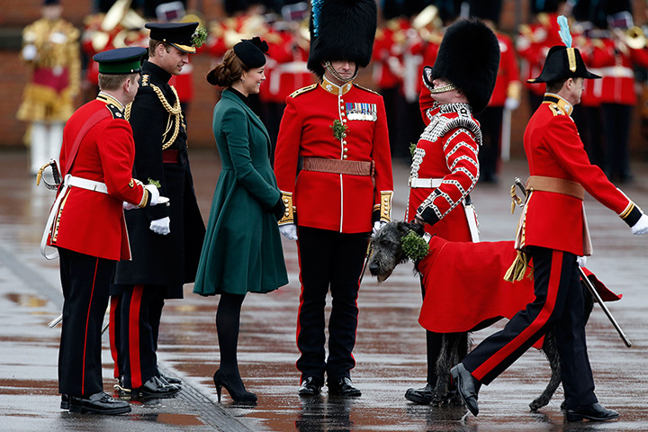
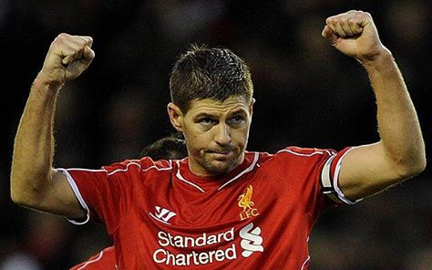
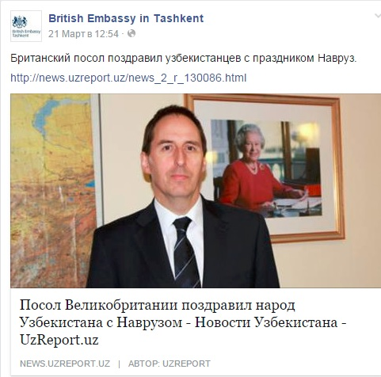

Slide 35

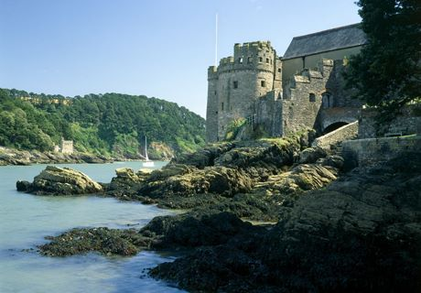
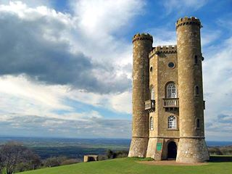

Slide 36
Some Conclusion Remarks
These two FB pages are among the most popular foreign social networks in Uzbekistan.
The U.S. Embassy FB Page is much more popular in Uzbekistan than the British one (52,663 vs 4,716 likes), nevertheless, the latter is even a bit more active in terms of numbers of postings.
There are some differences in the contents of the posts. The U.S. Embassy Page pays more attention to the education sphere, whereas the British one publishes mostly posts related to culture.

Slide 37
The United Kingdom’s Page engages the public a bit frequently rather than the American one. However, in the U.S. Embassy’s Page fans can rate its work.
The British Page uses local languages quite often, especially Russian, whereas the Americans do it rarely.
There are also a large number of similarities between the two mentioned Pages.

