Slide 1
Comparative analysis of the Russian and Chinese consulates social media activities in the USA (San Francisco): a public diplomacy perspective
By
D.K.
A.T.
O.M.
F.M.
S.M.

Slide 2
Plan:
Introduction
Followers analyses
Post analyses
Engagement of public
Conclusion

Slide 3
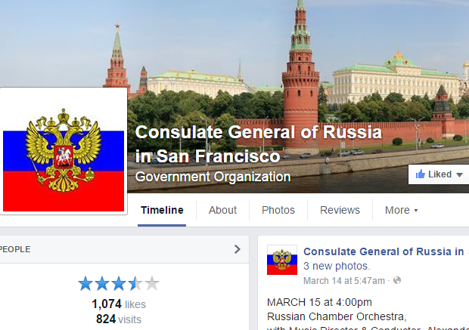
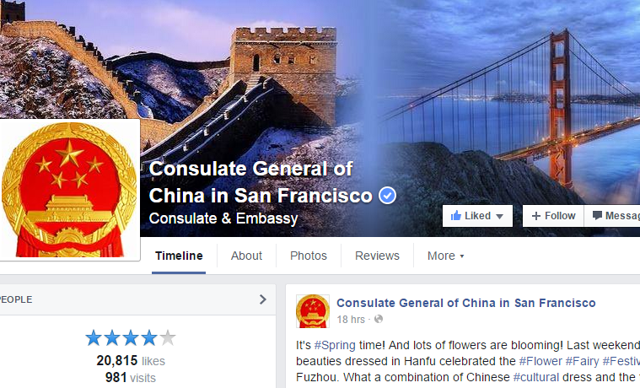
Consulate General of Russia in San Francisco
Created date: 2011 23 June
Consulate General of China in San Francisco
Created date: 2013 19 august

Slide 4
How many followers do they have?
Consulate General of Russia in San Francisco
Consulate General of China in San Francisco
1,073 likes
20,811 likes
In the last month has received 1.42% new fans.
In the last month has received -0.2% new fans

Slide 5
Gender proportion of Followers

Slide 6
Followers by country
Consulate General of Russia
Consulate General of China

Slide 7
Post analyses

Slide 8
Frequency of posts
Consulate General of Russia
Consulate General of China
Years | Total | Frequency
2015 (01.01.15-03.26.15) | 19 | Posts per Week: 1.65
2014 | 86 | Posts per week 1.86
2013 | 58 | Posts per week 1.1
2012 | 28 | Posts per month 2.01
2011 | 21 | Post per month 1.8
Years | Total | Frequency
2015 (01.01.15-03.26.15) | 76 | Posts per Day: 2.65
2014 | 75 | Posts per week:2.4
2013 | 111 | Posts per week:4.5

Slide 9
Post content
Consulates | Formal | Informal | About themselves | About the host country
Consulate General of Russia | 8 | 11 | 16 | 3
Consulate General of China | 22 | 54 | 65 | 11

Slide 10
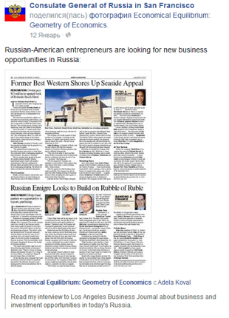
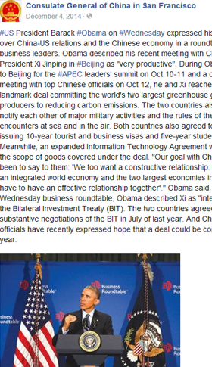
Consulate General of Russia
Consulate General of China

Slide 11
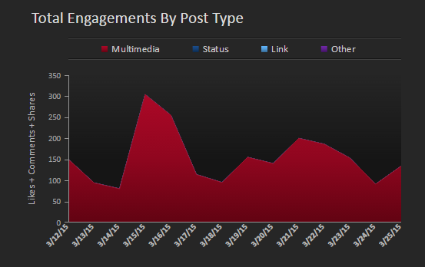
China

Slide 12
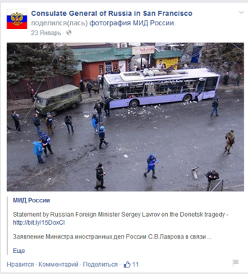
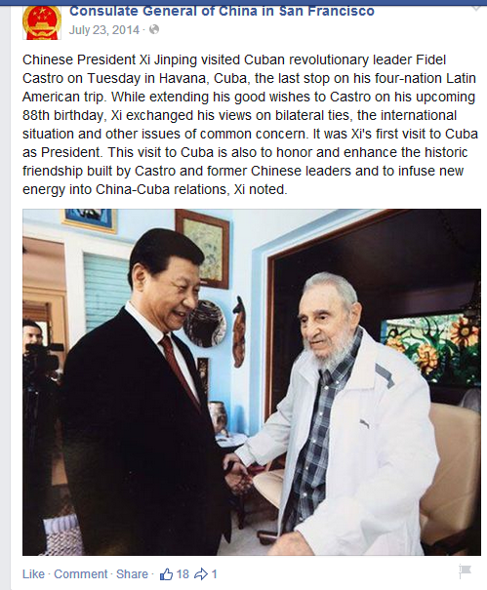
Reposting official information
Consulate General of Russia
Consulate General of China
www.mid.ru, www.lenta.ru, www.ria.ru
Mostly unsourced news and information

Slide 13
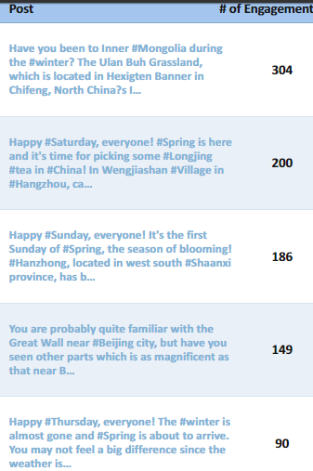

Top 5 Posts
Posts of China consulate
Posts of Russia consulate | likes
Russian Festival 2015 | 32
Возложение цветов на мемориальном кладбище | 25
"Red Army" - a movie about Soviet hockey players now in San Francisco theaters! 15 | 15
Церемония поминовения / Ceremony of Remembrance | 14
 | 10

Slide 14
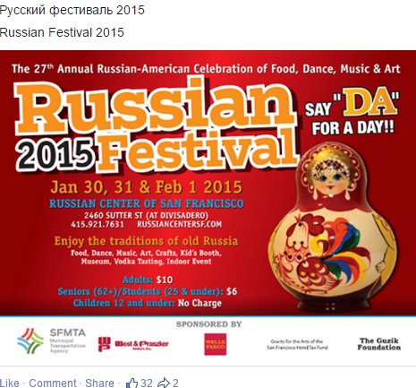
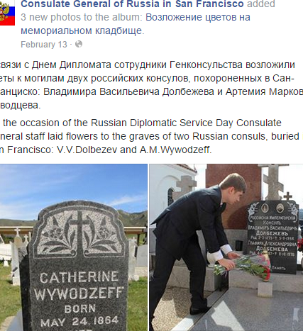
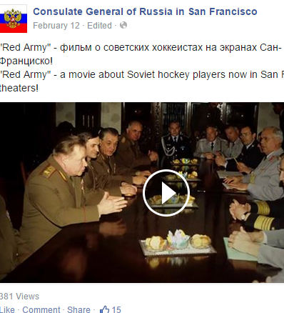
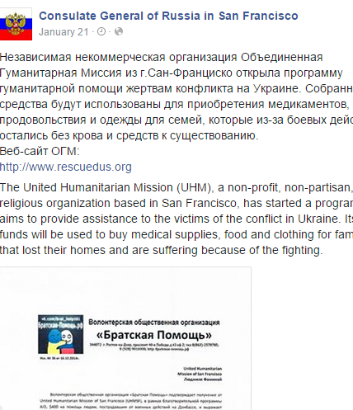
Consulate General of Russia

Slide 15
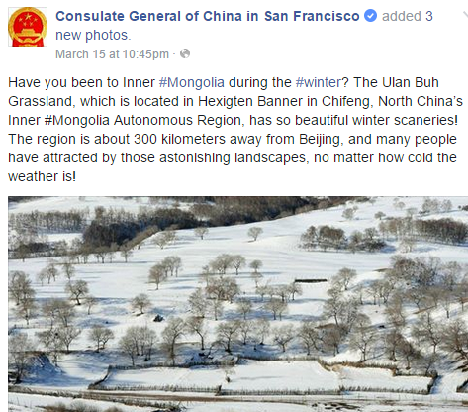
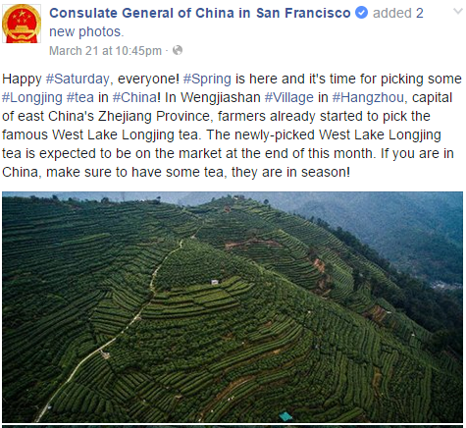
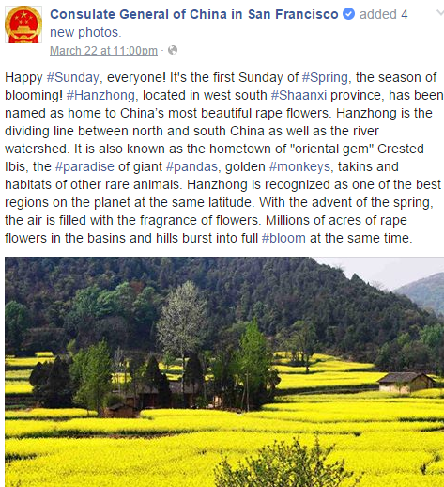
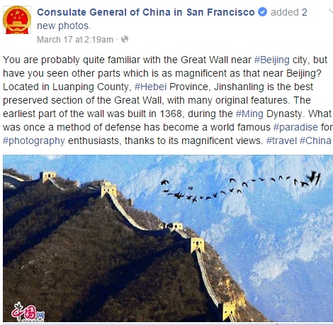
Consulate General of China

Slide 16
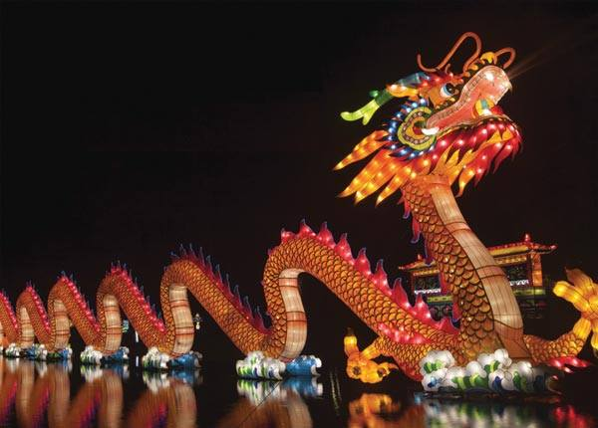
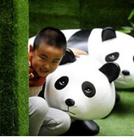
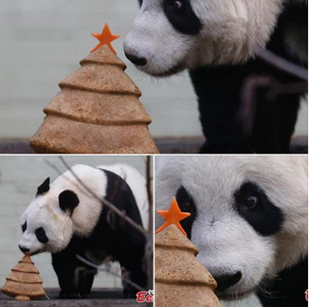
visual images
Consulate General of China in San Francisco
Iconic images

Slide 17
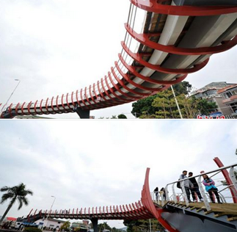
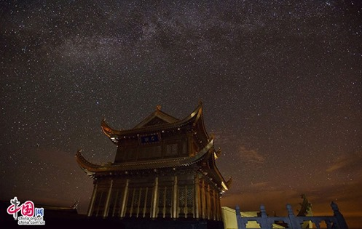
What kind of visual images do they use
Consulate General of China in San Francisco
Iconic images
Architecture

Slide 18
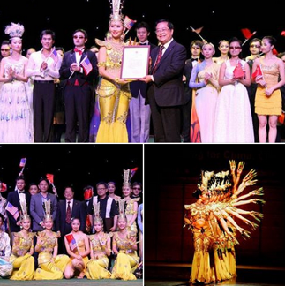
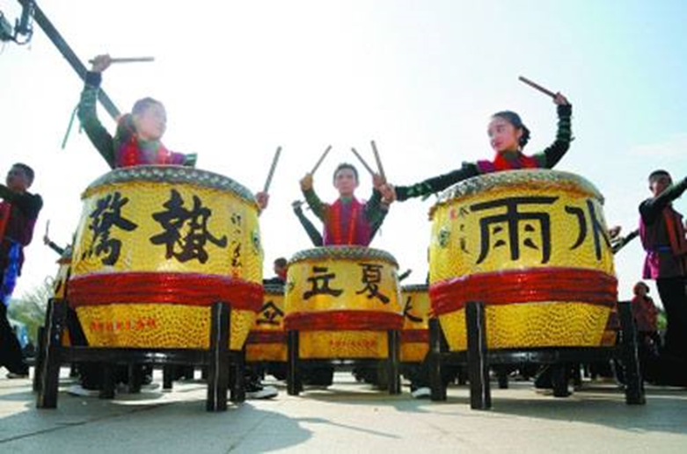
What kind of visual images do they use
Consulate General of China in San Francisco
Iconic images
Architecture
Festivals

Slide 19
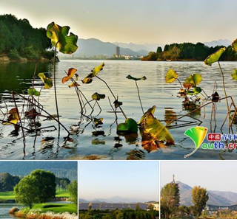
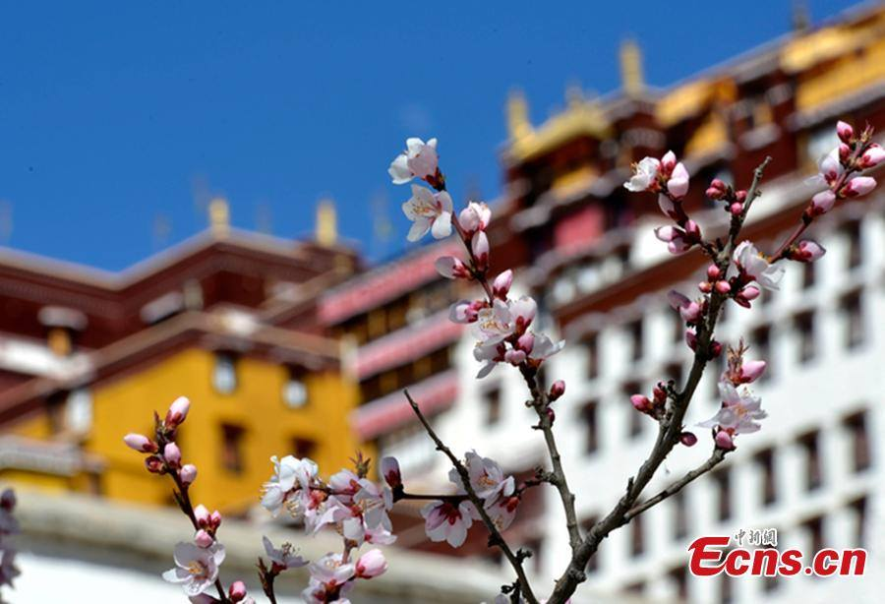
What kind of visual images do they use
Consulate General of China in San Francisco
Iconic images
Architecture
Festivals
Nature

Slide 20
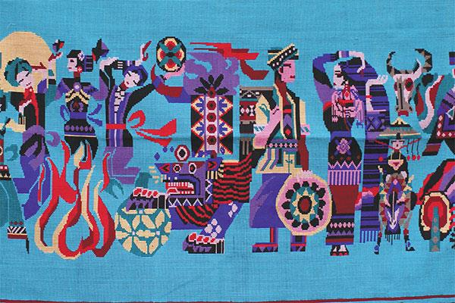
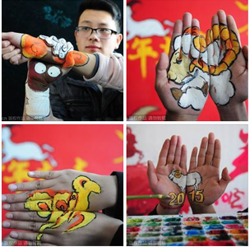
What kind of visual images do they use
Consulate General of China in San Francisco
Iconic images
Architecture
Festivals
Nature
Fantasy

Slide 21
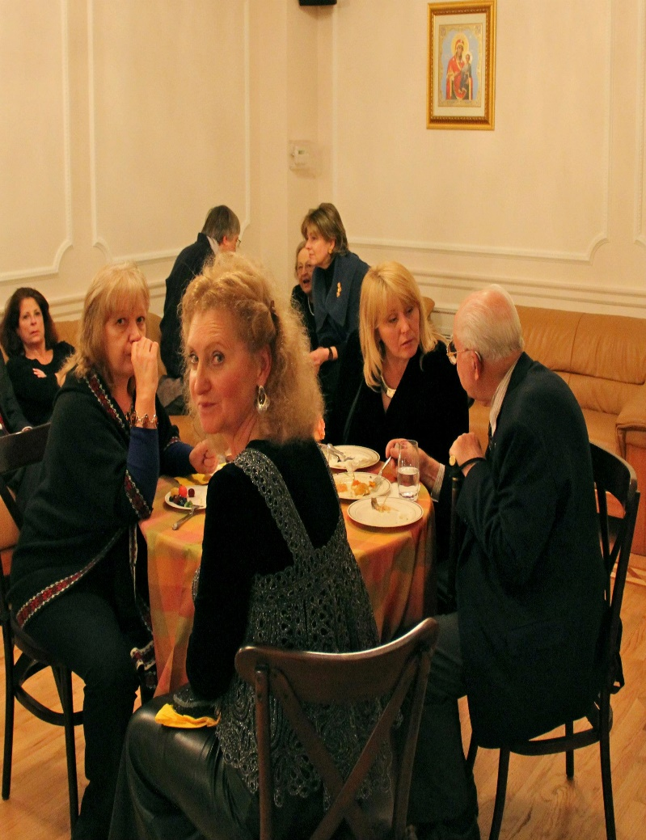
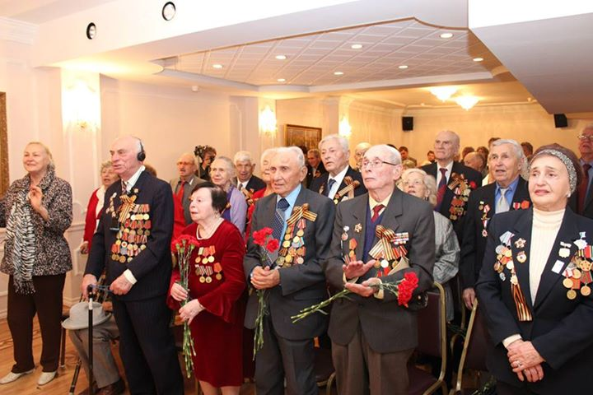
visual images
Consulate General of Russia in San Francisco
Official reception

Slide 22
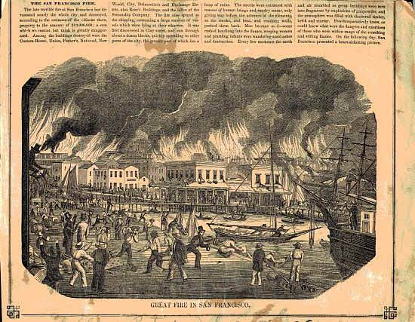
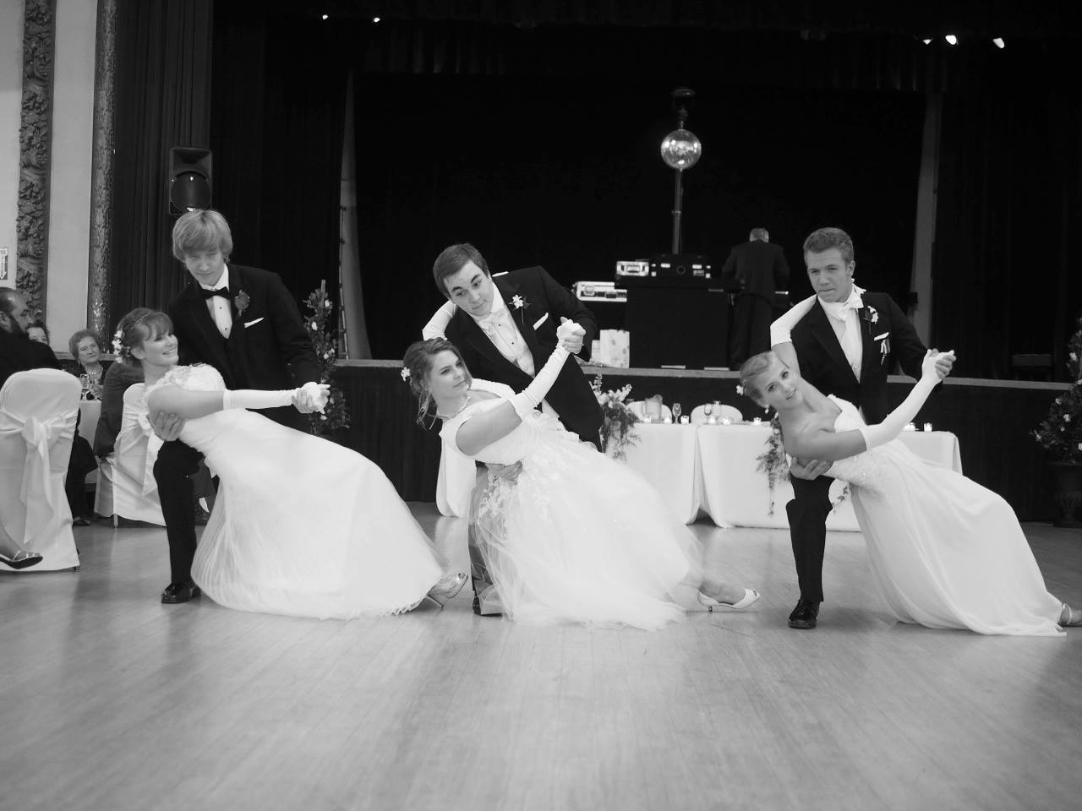
What kind of visual images do they use
Consulate General of Russia in San Francisco
Official reception
BW images

Slide 23
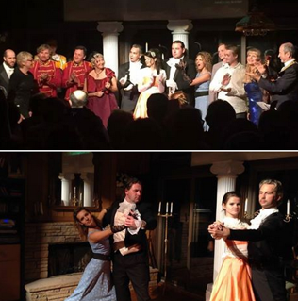
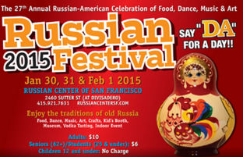
What kind of visual images do they use
Consulate General of Russia in San Francisco
Official reception
BW images
Festivals

Slide 24
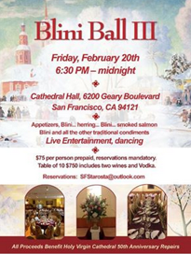
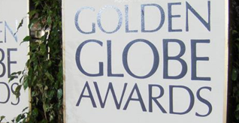
What kind of visual images do they use
Consulate General of Russia in San Francisco
Official reception
BW images
Festivals
Posters

Slide 25
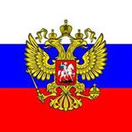
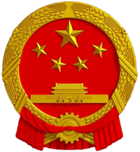
Official symbols
Consulate General of Russia in San Francisco
Consulate General of China in San Francisco
Flag
Flag
Emblem
Emblem

Slide 26
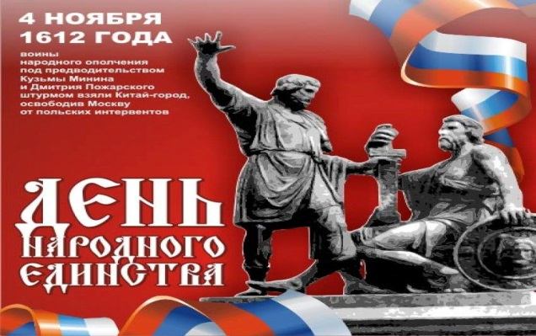
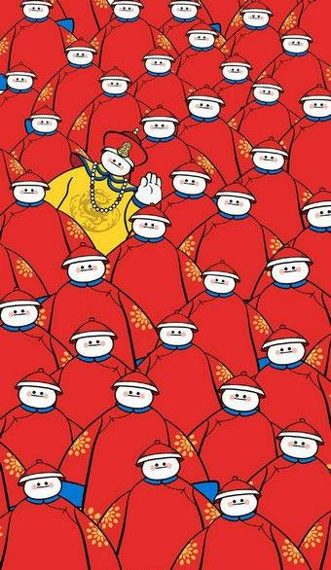
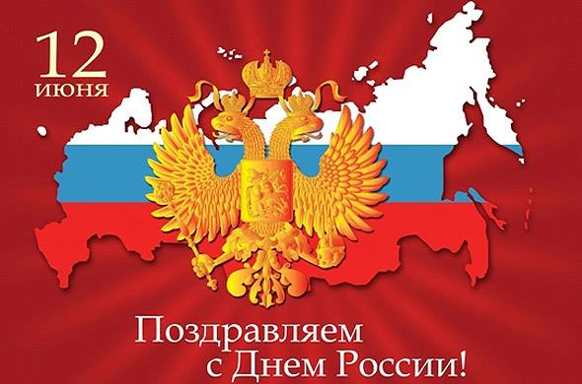
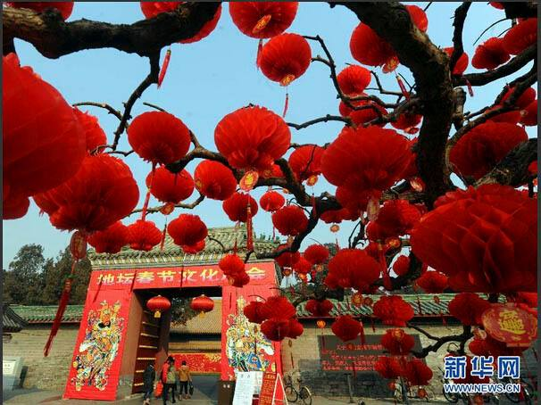
The most popular colors of pages
Consulate General of Russia in San Francisco
Consulate General of China in San Francisco
Red
Red
Yellow

Slide 27
Do they pay attention to culture, education, sport?

Slide 28
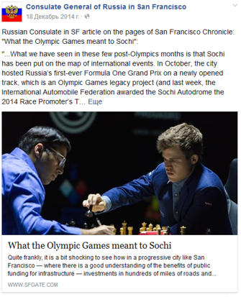
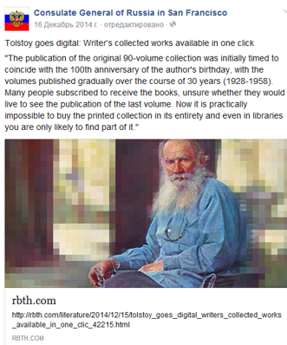
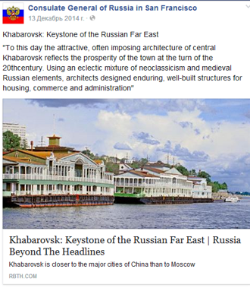
Consulate General of Russia

Slide 29
Do they pay attention to culture, education, sport?

Slide 30
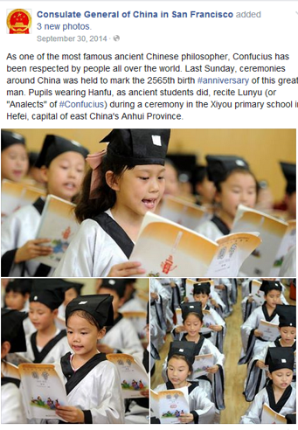
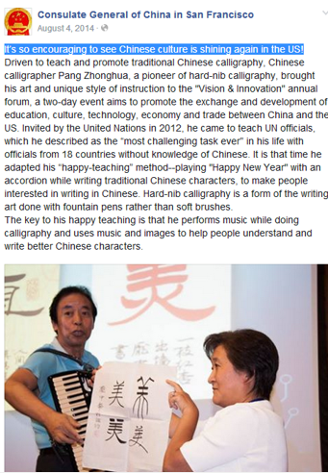
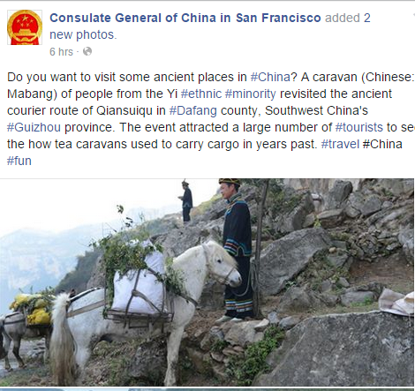
Consulate General of China

Slide 31
Use of Languages in the Posts
Consulate General of Russia
Consulate General of China
Consulate General of Russia
Simultaneously English and Russian
But shares and links only Russian
Only English
Sometimes name of places are used both in English and in Chinese

Slide 32
Public Engagement
Consulate General of Russia
Consulate General of China
Questions 0
Quizzes 0
Discussions 0
Questions 5
Quizzes 7
Discussions 0

Slide 33
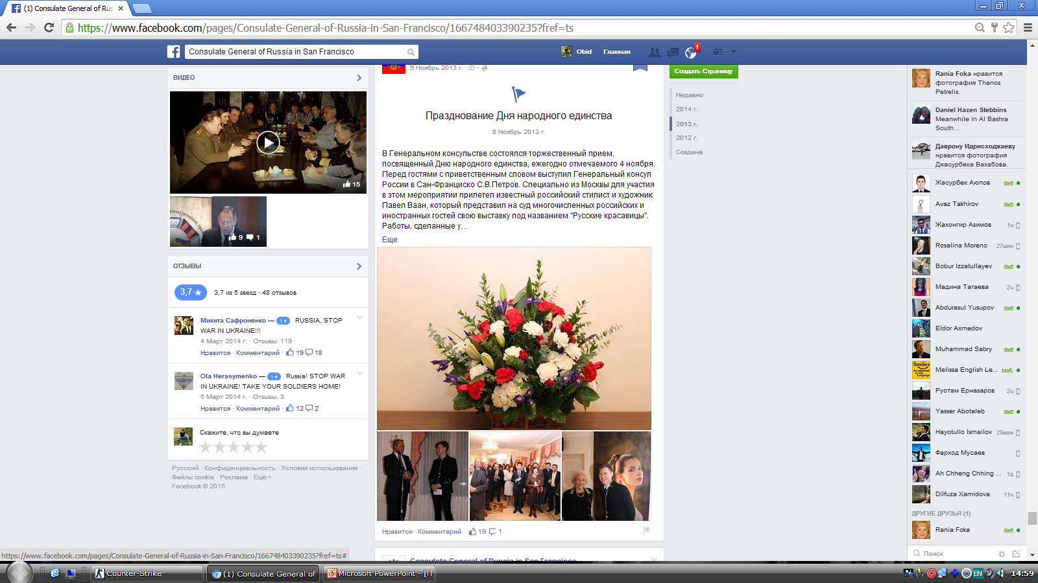
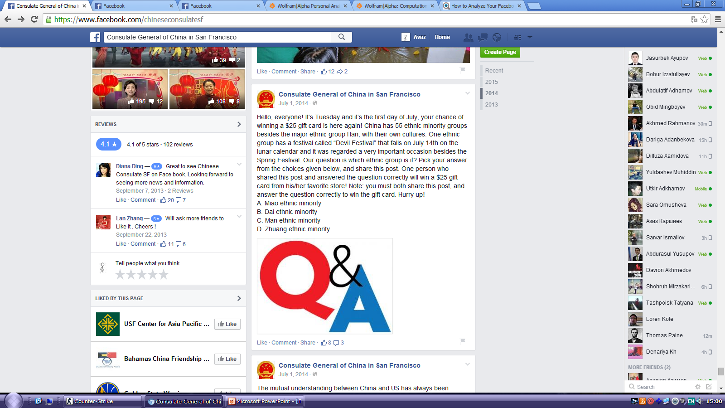
Public engagement
Consulate General of Russia in San Francisco
Consulate General of China in San Francisco
Events (National holidays, concerts, Election 2012)
Mostly quizzes

Slide 34
Engaging public
Consulate General of Russia
Type of engagement | Total | Average /Post
Comments | 34 | 1
Likes | 115 | 5
Shares | 15 | 2
Consulate General of China
Type of Engagement | Total | Average/Post
Comments | 54 | 2
Likes | 1,886 | 55
Shares | 211 | 6

Slide 35
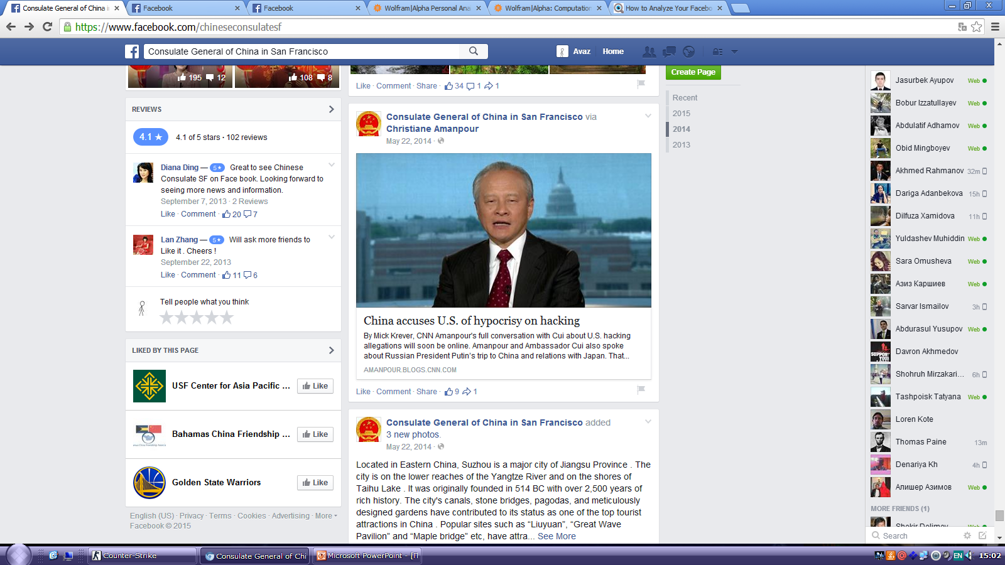
Critical on host country posts
Consulate General of Russia in San Francisco
Consulate General of China in San Francisco
None
Only one time

Slide 36


Rates
Consulate General of Russia in San Francisco
Consulate General of China in San Francisco

Slide 37


Readers opinion and critical comments
Consulate General of Russia in San Francisco

Slide 38


Readers opinion and critical comments
Consulate General of China in San Francisco

Slide 39
Conclusion
Differences
Chinese consulate is more active and has more followers and posts more frequently than Russian consulate (despite the fact that Russian consulate created its page rather earlier)
Chinese consulate posts more informal publications than Russian consulate
Chinese consulate pays more attention to engaging public, and Russian consulate pays more attention to posting official information
Russian consulate uses more its native (Russian) language
Usually Chinese consulate does not repost other source information, but Russian consulate sometimes (especially in 2011) reposted other source information more than its own posts

Slide 40

China consulate replies followers’ questions but Russia consulate never replies readers’ questions

Slide 41
Conclusion
Similarities
Followers of both consulates are mostly urban and middle aged individuals
Both consulates often use red color
Both consulates pay much attention to cultural sphere rather than to other areas

